Slide 1
ZOOM https://zoom.us https://learning.zoom.us/learn
Trade Unions for a Fair Recovery
Cascading Grant

Slide 2
Trade Unions for a Fair Recovery
Cascading Grant

Slide 3
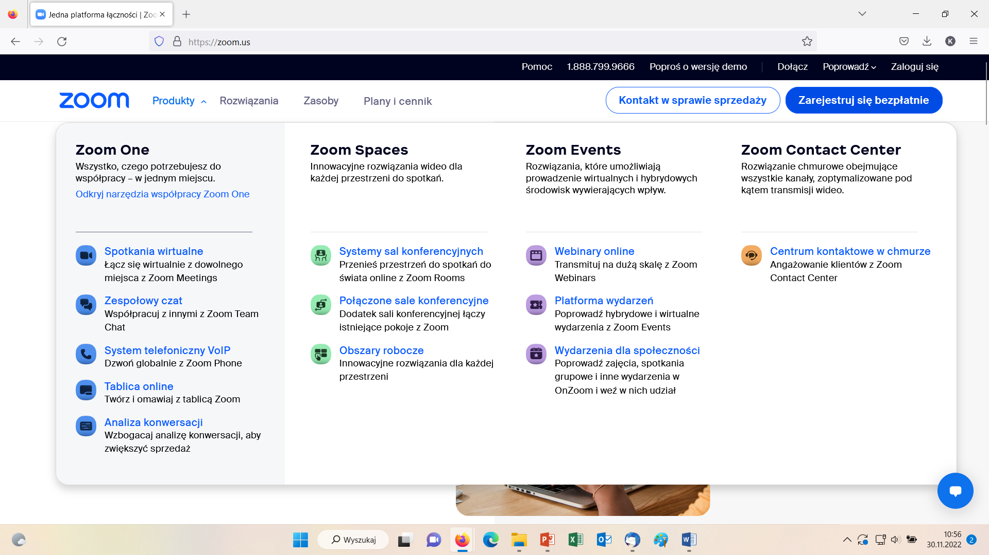
Trade Unions for a Fair Recovery
Cascading Grant

Slide 4
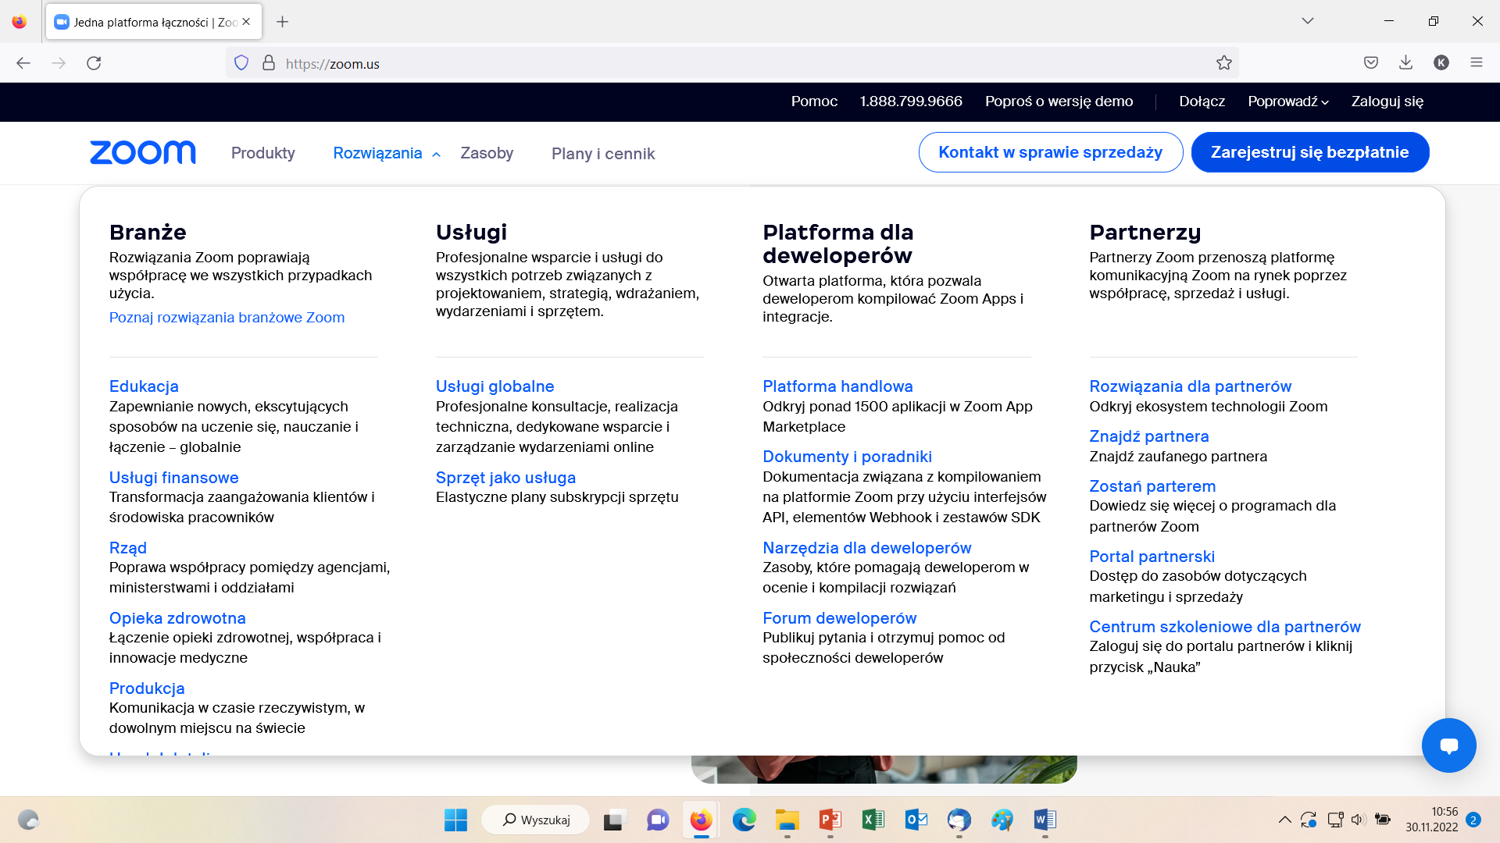
Trade Unions for a Fair Recovery
Cascading Grant

Slide 5
Trade Unions for a Fair Recovery
Cascading Grant

Slide 6
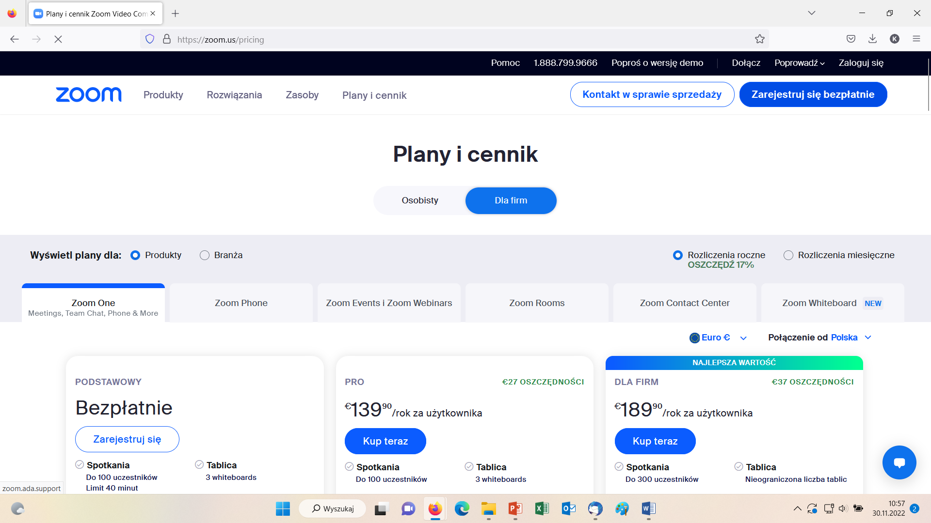
Trade Unions for a Fair Recovery
Cascading Grant

Slide 7
Trade Unions for a Fair Recovery
Cascading Grant

Slide 8
Trade Unions for a Fair Recovery
Cascading Grant

